Slide 1



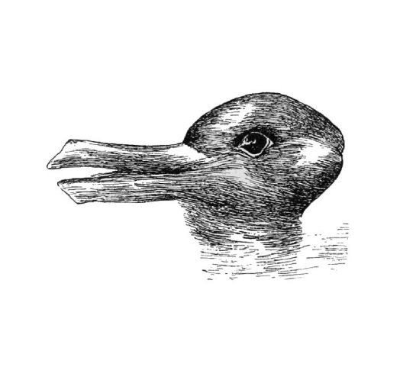
Wait... what did you really see?
POP QUIZ
"The lady hit the man with an umbrella."
Who was holding the umbrella?
Option A: The lady used it as a weapon.
Option B: The man was carrying it.
Without structure, language is an optical illusion.

Slide 2

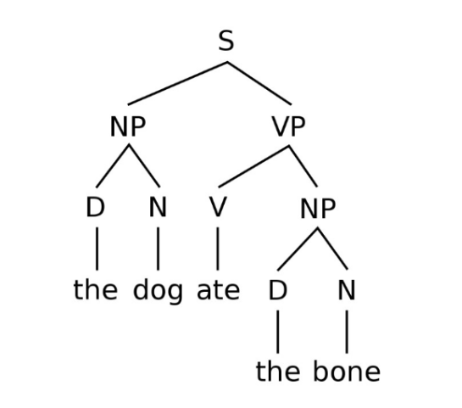






The Blueprint: S → NP VP
A correct syntax tree always splits the sentence into two main branches first. Think of it as the sentence's backbone.
Sentence The root of the entire thought.
Noun Phrase (Subject) The "Who" or "What". (e.g., "The small boy")
Verb Phrase (Predicate) The "Action". (e.g., "helped you")

Slide 3
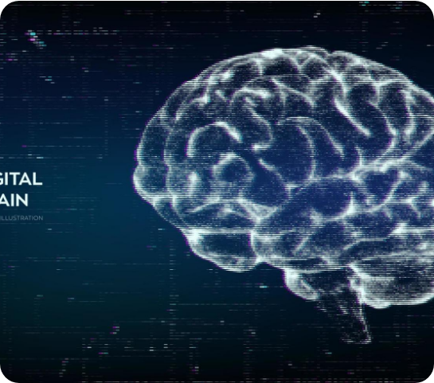

Why this matters right now
Your phone is drawing trees.
Every time you speak to Siri, Alexa, or use Google Translate, an AI is instantly building these trees to understand you.
Key Insight: Machines don't "read" words linearly like us; they parse structure to calculate meaning.

Slide 4




Image Sources
https://images.aeonmedia.co/images/94d113b4-dd5f-492a-91f3-19ea91936db3/sized-psm_v54_d328_optical_illusion_of_a_duck_or_a_rabbit_head.jpg?width=3840&quality=75&format=auto
Source: aeon.co
https://miro.medium.com/1*GUKsSnLC76IQ4iCxZgbcmw.png
Source: medium.com
https://static.vecteezy.com/system/resources/previews/017/603/631/non_2x/brain-abstract-digital-human-brain-in-a-distorted-glitch-style-neural-network-iq-testing-artificial-intelligence-virtual-emulation-technology-concept-brainstorm-think-idea-illustration-vector.jpg
Source: www.vecteezy.com

